Slide 1
Unit-4
Security & Protection

Slide 2
Role of OS in Security
OS employ security and protection measures to prevent a person from illegally using resources in computer system.
It means the data are used by authorized users.
Os uses two categories of techniques to counter threats to data and programs:
Security measures deal with threats to resources that come from outsider threats.
Protection measure deals with the internal threats.

Slide 3
Goals of Security and Protection
There are 4 goals:
Secrecy
Privacy
Authenticity
Integrity

Slide 4
Intrusion
Entrance by force or without permission or welcome.
Any set of actions that attempt to compromise the integrity, confidentiality or availability of a resource.
The intentional insertion of electromagnetic energy into transmission paths in any manner with the objective of deceiving operators or of causing confusion.

Slide 5
Types of Intruders
Masquerader (outsider)
Misfeasor (insider)
Clandestine User (supervisory controller)

Slide 6
Intrusion detection approaches
Statistical anomaly detection: Involves the collection of data relating to the behavior of legitimate users over a period of time. Then statistical tests are applied to observed behavior to determine with a high level of confidence whether that behavior is not legitimate user behavior.
    Threshold detection(no of occurrence counted)
    Profile based(past behavior checking)
Rule-based detection: Involves an attempt to define a set of rules that can be used to decide that a given behavior is that of an intruder.
    Rule based analogy detection(historical records analyzed)
    Rule based penetration identification(check the known and unknown penetrations)

Slide 7
Password Management
Password Protection: The front line of defense against intruders is the password system. Virtually all multiuser systems require that a user provide not only a name or identifier (ID) but also a password. The password serves to authenticate the ID of the individual logging on to the system. In turn, the ID provides security in the following ways:
  The ID determines whether the user is authorized to gain access to a system.
  The ID determines the privileges accorded to the user.

Slide 8
Password Management
The Vulnerability of Passwords: let us consider a scheme that is widely used on UNIX:
  Each user selects a password up to eight characters.
  This is converted into a 56-bit value (key input to an encryption routine).
  The encryption routine is based on DES. The DES algorithm is modified using a 12-bit.
  This value is related to the time at which the password is assigned to the user.

Slide 9
Password Management
  The modified DES algorithm is exercised with a data input consisting of a 64-bit block of zeros.
  The output of the algorithm then serves as input for a second encryption.
  This process is repeated for a total of 25 encryptions.
  The resulting 64-bit output is then translated into an 11-character sequence.
  The hashed password is then stored, together with a plaintext copy of the salt, in the password file

Slide 10
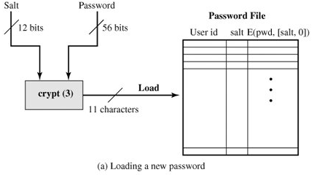
Password Management

Slide 11
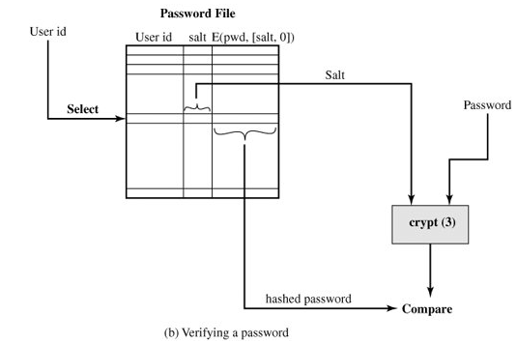
Password Management

Slide 12
How to Choose a secure password?
Do NOT use words or phrases that have personal significance.
Mix letters, numbers and symbols, and use case sensitivity
Try to memorize the password, and avoid writing it down
Do not use the same password for everything
Use a password manager (PM). It is a utility that creates an encrypted file where your passwords are stored.
Try to use "nonsense words."
Do not tell anybody your password.

Slide 13
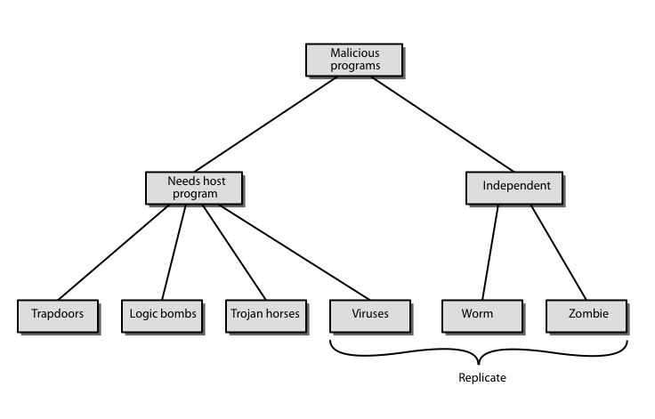
Security Breaches(Malicious Software)
Notes:
The terminology used for malicious software presents problems because of a lack of universal agreement on all terms and because of overlap. Stallings Table 19.1, and this diagram from 3/e, provide a useful taxonomy. It can be divided into two categories: those that need a host program (being a program fragment eg virus), and those that are independent programs (eg worm); alternatively you can also differentiate between those software threats that do not replicate (are activated by a trigger) and those that do (producing copies of themselves). Will now survey this range of malware.

Slide 14
Backdoor or Trapdoor
secret entry point into a program
allows those who know access bypassing usual security procedures
have been commonly used by developers
a threat when left in production programs allowing exploited by attackers
very hard to block in O/S
Notes:
A backdoor, or trapdoor, is a secret entry point into a program that allows someone that is aware of it to gain access without going through the usual security access procedures. Have been used legitimately for many years to debug and test programs, but become a threat when left in production programs. It is difficult to implement operating system controls for backdoors. Security measures must focus on the program development and software update activities.

Slide 15
Logic Bomb
one of oldest types of malicious software
code embedded in legitimate program
activated when specified conditions met
  E.g., presence/absence of some file
  particular date/time
  particular user
when triggered typically damage system
  modify/delete files/disks, halt machine, etc.
Notes:
A logic bomb is one of the oldest types of program threat, being code embedded in some legitimate program that is set to “explode” when certain conditions, such as the examples shown, are met. Once triggered, a bomb may alter or delete data or entire files, cause a machine halt, or do some other damage.

Slide 16
Trojan Horse
  program with hidden side-effects
  which is usually superficially attractive
  E.g., game, s/w upgrade, etc.
  when run performs some additional tasks
  allows attacker to indirectly gain access they do not have directly
  often used to propagate a virus/worm or install a backdoor
  or simply to destroy data
  Mail the password file.
Notes:
A Trojan horse is a useful, or apparently useful, program or command procedure (eg game, utility, s/w upgrade etc) containing hidden code that performs some unwanted or harmful function that an unauthorized user could not accomplish directly. Commonly used to make files readable, propagate a virus or worm, or simply to destroy data.

Slide 17
Zombie
program which secretly takes over another networked computer
then uses it to indirectly launch attacks
(difficult to trace zombie’s creator)
often used to launch distributed denial of service (DDoS) attacks
exploits known flaws in network systems
Notes:
A zombie is a program that secretly takes over another Internet-attached computer and then uses that computer to launch attacks that are difficult to trace to the zombie’s creator. Zombies are used in denial-of-service attacks, being planted on hundreds of computers belonging to unsuspecting third parties, and then used to overwhelm the target Web site by launching an overwhelming onslaught of Internet traffic. Typically zombies exploit known flaws in networked computer systems.

Slide 18
Viruses
a piece of self-replicating code attached to some other code
attaches itself to another program and executes secretly when the host program is executed.
propagates itself & carries a payload
  carries code to make copies of itself
  as well as code to perform some covert task
Notes:
A virus is a piece of software that can “infect” other programs by modifying them; the modification includes a copy of the virus program, which can then go on to infect other programs. It can be compared to biological viruses, and like them, a computer virus carries in its instructional code the recipe for making perfect copies of itself. Once a virus is executing, it can perform any function, such as erasing files and programs.

Slide 19
Virus Operation
virus phases:
  dormant – waiting on trigger event
  propagation – replicating to programs/disks
  triggering – by event to execute payload
  execution – of payload
details usually machine/OS specific
  exploiting features/weaknesses
Notes:
During its lifetime, a typical virus goes through the following four phases:
• Dormant phase: virus is idle, waiting for trigger event (eg date, program or file , disk capacity). Not all viruses have this stage
• Propagation phase: virus places a copy of itself into other programs / system areas
• Triggering phase: virus is activated by some trigger event to perform intended function
• Execution phase: desired function (which may be harmless or destructive) is performed
Most viruses work in a manner specific to a particular operating system or even hardware platform, and are designed to take advantage of the details and weaknesses of particular systems.

Slide 20
Types of Viruses
  can classify on basis of how they attack
  parasitic virus -attaches itself to executable files and replicates
  memory-resident virus -lodges in the main memory and infects every program that executes.
  boot sector virus -infects a boot record and spreads when the system is booted from the disk
Notes:
There has been a continuous arms race between virus writers and writers of antivirus software, with the following categories being among the most significant types of viruses:
• Parasitic virus: traditional and still most common form of virus, it attaches itself to executable files and replicates when the infected program is executed
• Memory-resident virus: Lodges in main memory as part of a resident system program, and infects every program that executes
• Boot sector virus: Infects a master boot record and spreads when a system is booted from the disk containing the virus
• Stealth virus: a virus explicitly designed to hide itself from detection by antivirus software
• Polymorphic virus: mutates with every infection, making detection by the “signature”of the virus impossible.
• Metamorphic virus: mutates with every infection, rewriting itself completely at each iteration changing behavior and/or appearance, increasing the difficulty of detection.

Slide 21
Types of Viruses…
  Stealth -designed to hide itself from antivirus software
  polymorphic virus -a virus that mutates with every infection, making detection very difficult
  metamorphic virus -mutates with every infection, but rewrites itself completely every time. Making it extremely difficult to detect.
Notes:
There has been a continuous arms race between virus writers and writers of antivirus software, with the following categories being among the most significant types of viruses:
• Parasitic virus: traditional and still most common form of virus, it attaches itself to executable files and replicates when the infected program is executed
• Memory-resident virus: Lodges in main memory as part of a resident system program, and infects every program that executes
• Boot sector virus: Infects a master boot record and spreads when a system is booted from the disk containing the virus
• Stealth virus: a virus explicitly designed to hide itself from detection by antivirus software
• Polymorphic virus: mutates with every infection, making detection by the “signature”of the virus impossible.
• Metamorphic virus: mutates with every infection, rewriting itself completely at each iteration changing behavior and/or appearance, increasing the difficulty of detection.

Slide 22
Email Virus
spread using email with attachment containing a macro virus
triggered when user opens attachment
or worse even when mail viewed by using scripting features in mail agent
hence propagates very quickly
usually targeted at Microsoft Outlook mail agent & Word/Excel documents
Notes:
A more recent development in malicious software is the e-mail virus. The first rapidly spreading e-mail viruses, such as Melissa, made use of a Microsoft Word macro embedded in an attachment, triggered when the attachment was opened. At the end of 1999, a more powerful version of the e-mail virus appeared, activated merely by opening an e-mail that contains the virus rather than opening an attachment. As a result, instead of taking months or years to propagate, now take only hours.This makes it very difficult for antivirus software to respond before much damage is done. Ultimately, a greater degree of security must be built into Internet utility and application software on PCs to counter this growing threat.

Slide 23
Worms
replicating but not infecting program
(does not attach itself to a program)
typically spreads over a network
  Morris Internet Worm in 1988
using users distributed privileges or by exploiting system vulnerabilities
worms perform unwanted functions
widely used by hackers to create zombie PC's, subsequently used for further attacks, esp DoS
major issue is lack of security of permanently connected systems, esp PC's
Notes:
A worm is a program that can replicate itself and send copies from computer to computer across network connections. Upon arrival, the worm may be activated to replicate and propagate again, and usually to also perform some unwanted function. A worm actively seeks out more machines to infect and each machine that is infected serves as an automated launching pad for attacks on other machines. To replicate itself, a network worm uses some sort of network vehicle such as email, remote execution, or remote login. Once active within a system, a network worm can behave as a computer virus or bacteria, or it could implant Trojan horse programs or perform any number of disruptive or destructive actions.

Slide 24
Worm Operation
worm has phases like those of viruses:
    dormant
    propagation
        search for other systems to infect
        establish connection to target remote system
        replicate self onto remote system
    triggering
    execution
Notes:
A network worm exhibits the same characteristics as a computer virus: a dormant phase, a propagation phase, a triggering phase, and an execution phase. The propagation phase generally:
Searches for other systems to infect by examining host tables etc
2. Establishes a connection with a remote system
3. Copies itself to the remote system and cause the copy to be run.

Slide 25
Morris Worm
best known classic worm
released by Robert Morris in 1988
targeted Unix systems
using several propagation techniques
  simple password cracking of local pw file
  exploit bug in finger daemon
  exploit debug trapdoor in sendmail daemon
if any attack succeeds then replicated self
Notes:
Until recently, the best known was the Morris worm released onto the Internet by Robert Morris in 1998. It was designed to spread on UNIX systems and used a number of different techniques for propagation, including cracking the local password file to get logins/passwords, exploiting a bug in the finger protocol, or exploiting a trapdoor in the debug option of the sendmail mail daemon. If any attack succeeded then the worm had a means of running on another system and replicating itself.

Slide 26
Stack & Buffer Overflow
Application reserves adjacent memory locations (buffer) to store arguments to a function, or variable values.
Attacker gives an argument too long to fit in the buffer.
The application copies the whole argument, overflowing the buffer and overwriting memory space.
If the conditions are “just right” this will enable to attacker to gain control over the program flow and execute arbitrary code, with the same privileges of the original application.

Slide 27
Goals of Protection
Need to prevent mischievous activity.
Early detection of the error.
Distinguishes b/n authorized & unauthorized usage.
Provide a mechanism for the enforcement of the policies governing resource use.

Slide 28
Guiding Principles of Protection
Principle of least privilege
  Programs, users and systems should be given just enough privileges to perform their tasks
Separate policy from mechanism
  Mechanism: the stuff built into the OS to make protection work
  Policy: the data that says who can do what to whom

Slide 29
Domain of Protection
A computer system is the collection of Process & Objects/resources.
A process should allowed to access only those resources for which
  It has authorized access
  It is having currently requirement to complete the tasks.
The second requirement is known as need-to-know principle.
To use these scheme process operates within a protection domain.
Here each Domain is ordered pair of <object name , right-sets>

Slide 30
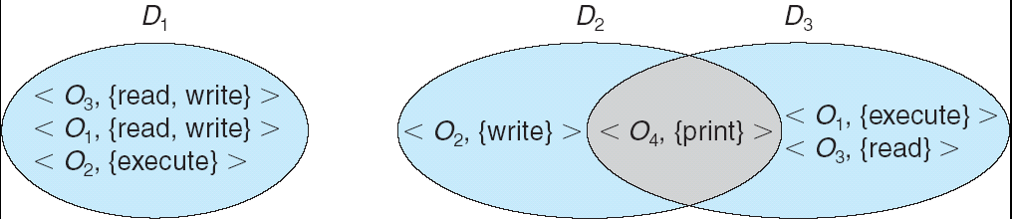
Domain Structure
Access-right = <object-name, rights-set>
where rights-set is a subset of all valid operations that can be performed on the object.
Domain = set of access-rights

Slide 31
Conceptual Representation – Access Matrix
Viewed protection as a matrix (access matrix)
Rows represent domains
Columns represent objects
Access(i , j) is set of operations that process executing in Domain_{i} can invoke on Object_{j.}

Slide 32
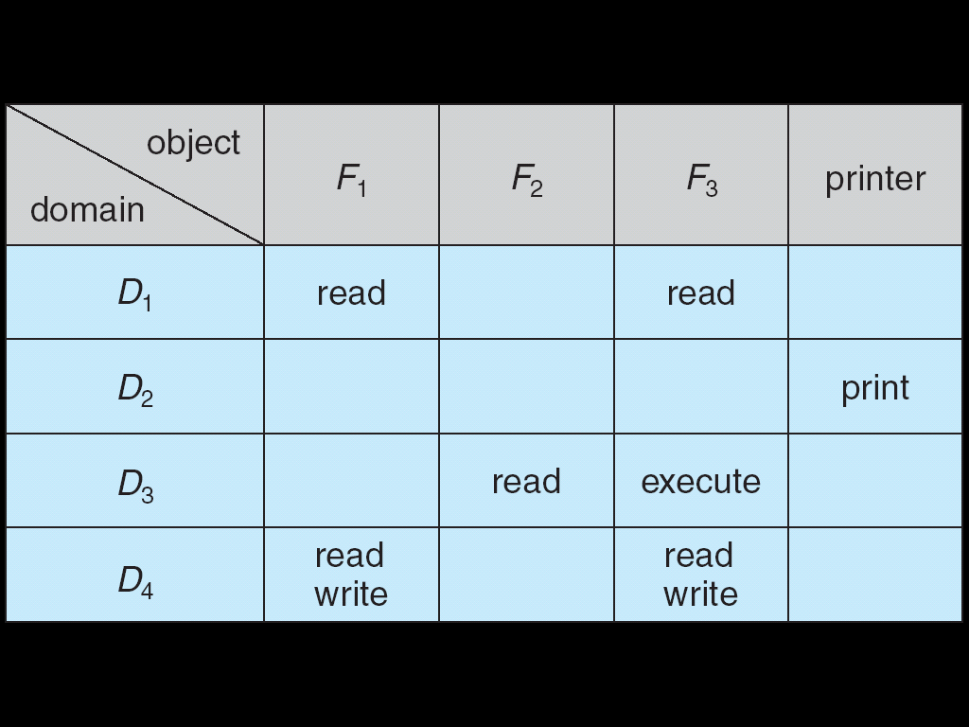
Textbook Access Matrix
Columns are access control lists (ACLs)
    Associated with each object
Rows are capabilities
    Associated with each user, group, or domain

Slide 33
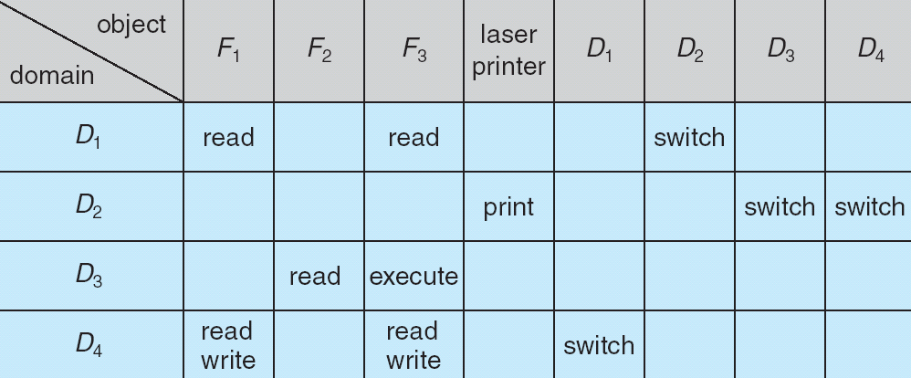
Changing Domains

Slide 34
ACLs vs. Capabilities
Access Control List: Focus on resources
  Good if resources greatly outnumber users
  Can be implemented with minimal caching
  Can be attached to objects (e.g., file metadata)
  Good when the user who creates a resource has authority over it
Capability System: Focus on users
  Good if users greatly outnumber resources
  Lots of information caching is needed
  Good when a system manager has control over all resources
Notes:
The issue is one of HOW we view the problem, WHERE the control information is stored, and WHEN the tests and changes are made.
Tests for rights needs to be delayed to the last minute…
Therefore, the time frame to think about is Run-Time
STEP BACK: Storage for access control information is theoretically independent of EITHER if the objects, but run-time efficiency suggests an answer...

Slide 35
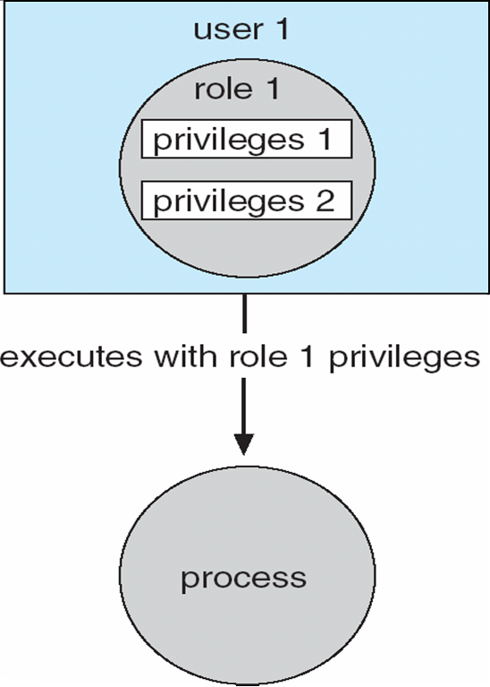
Role-based Access Control in Solaris 10

